Slide 1

Mortgage Loan Clustering Project
Baiting Gai, Jiatian Xie, Ziyi Zhang

Slide 2
Agenda
Background & Data Description
Findings From Exploratory Data Analysis
Feature Engineering & Feature Selection
Dimension Reduction
Clustering Models
Cluster Analysis
Conclusions

Slide 3
Background & Data Description
Help investors gain a better understanding of the credit performance of a portion of single-family loans owned or guaranteed by Fannie Mae
Dataset includes a subset of Fannie Mae’s 30-year, fixed-rate, fully documented, single-family amortizing loans that the company owned or guaranteed on or after January 1, 2000
“Acquisition” and “Performance” data
“Acquisition”: loan and borrower characteristics
“Performance”: flags for intermediate performance milestones and values from the last, most-recent row
Project Objectives: group the loans and analyze the differences between the groups
Notes:
In support of its credit risk sharing programs, Fannie Mae released an extensive dataset beginning in 2013 that provides insight into the credit performance of a portion of Fannie Mae’s single-family book of business.
Now consisting of nearly 22 million records, the dataset provides monthly loan-level detail and is offered to help investors gain a better understanding of the credit performance of a portion of single-family loans owned or guaranteed by Fannie Mae.
The public dataset includes a subset of Fannie Mae’s 30-year, fixed-rate, fully documented, single-family amortizing loans that the company owned or guaranteed on or after January 1, 2000.
Acquisition” file includes static mortgage loan data at the time of the mortgage loan origination and delivery to Fannie Mae.
“Performance” file provides monthly performance data for each loan, from acquisition up until its current status as of the previous quarter.

Slide 4
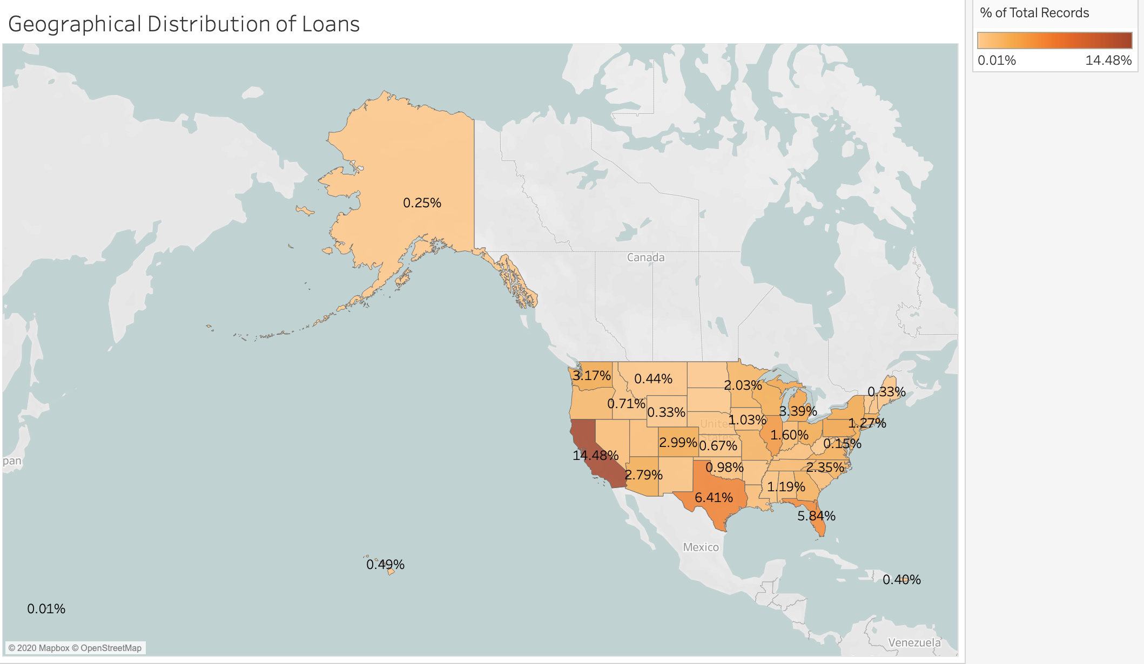
EDA——Geographical Distribution
Notes:
California has the most loans
Too many states

Slide 5
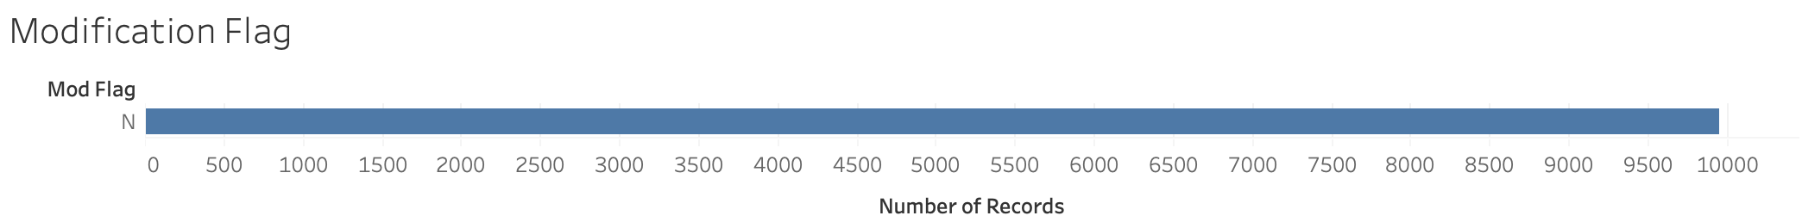
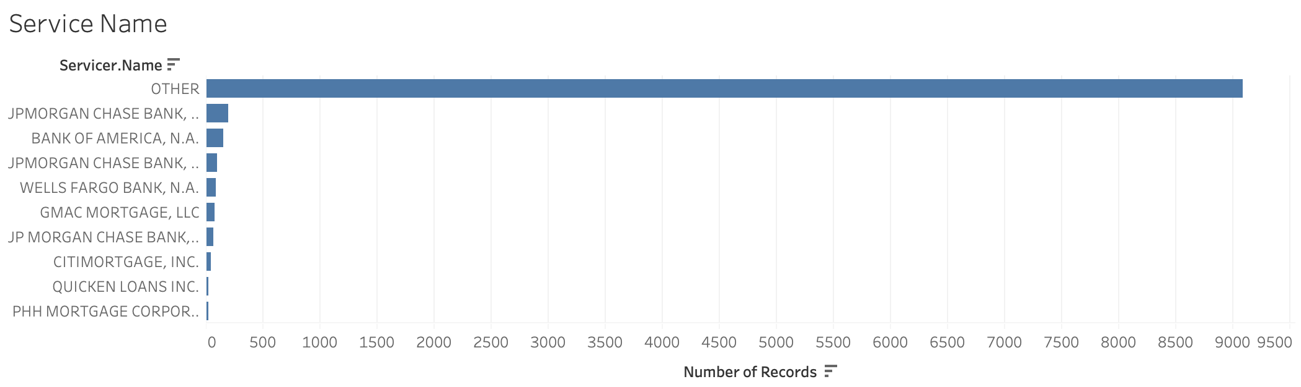
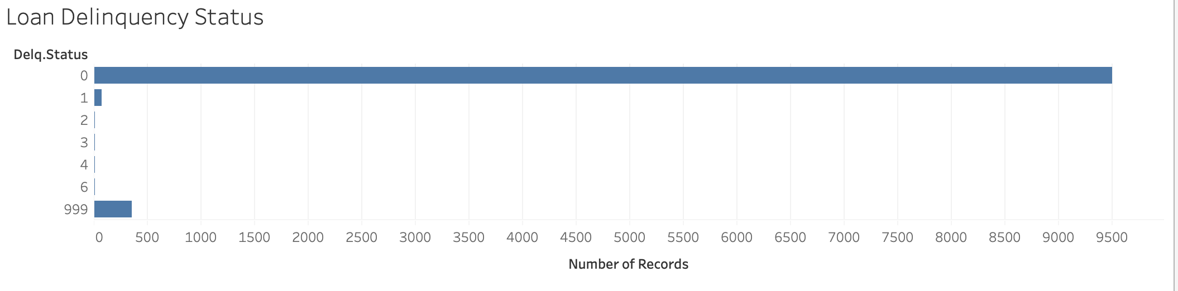
EDA——Too many features are imbalanced
Notes:
Current Loan Delinquency Status
The values in these variables are concentrated in on category
So we will not use these variables in the modeling cuz it can not tell the clusters

Slide 6
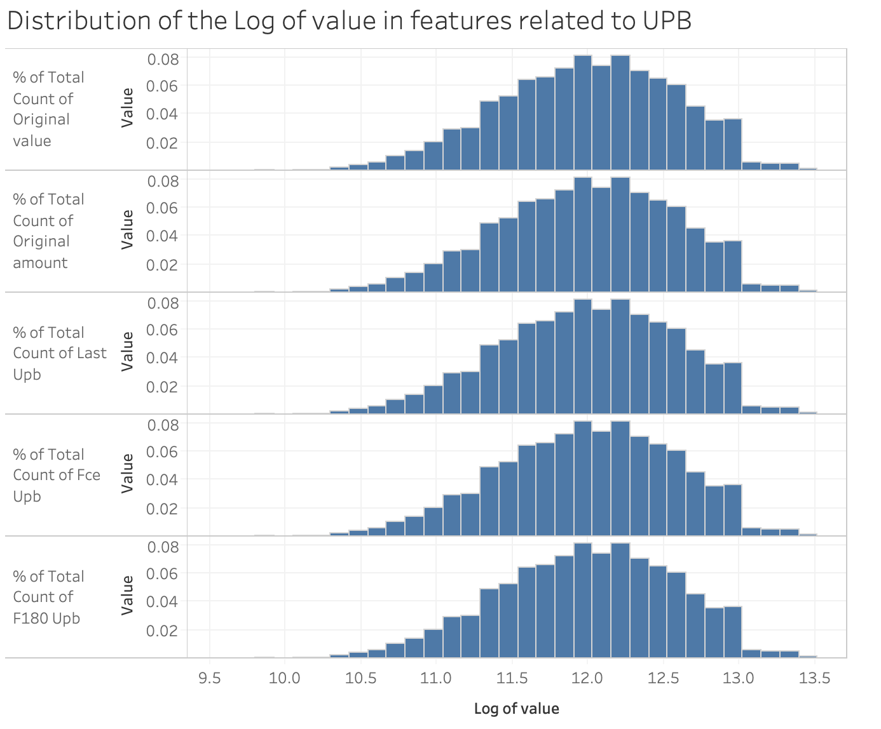
EDA——Distribution of “Money” Variables
Same Distribution of “Money” Variables
Notes:
First credit event upb
They are in the same distribution, which means that they are vey little differences between the variables.
There exists multicollinearity
So we will just keep one variable, original amount, which means the original amount of the mortgage loan as indicated by the mortgage documents.

Slide 7
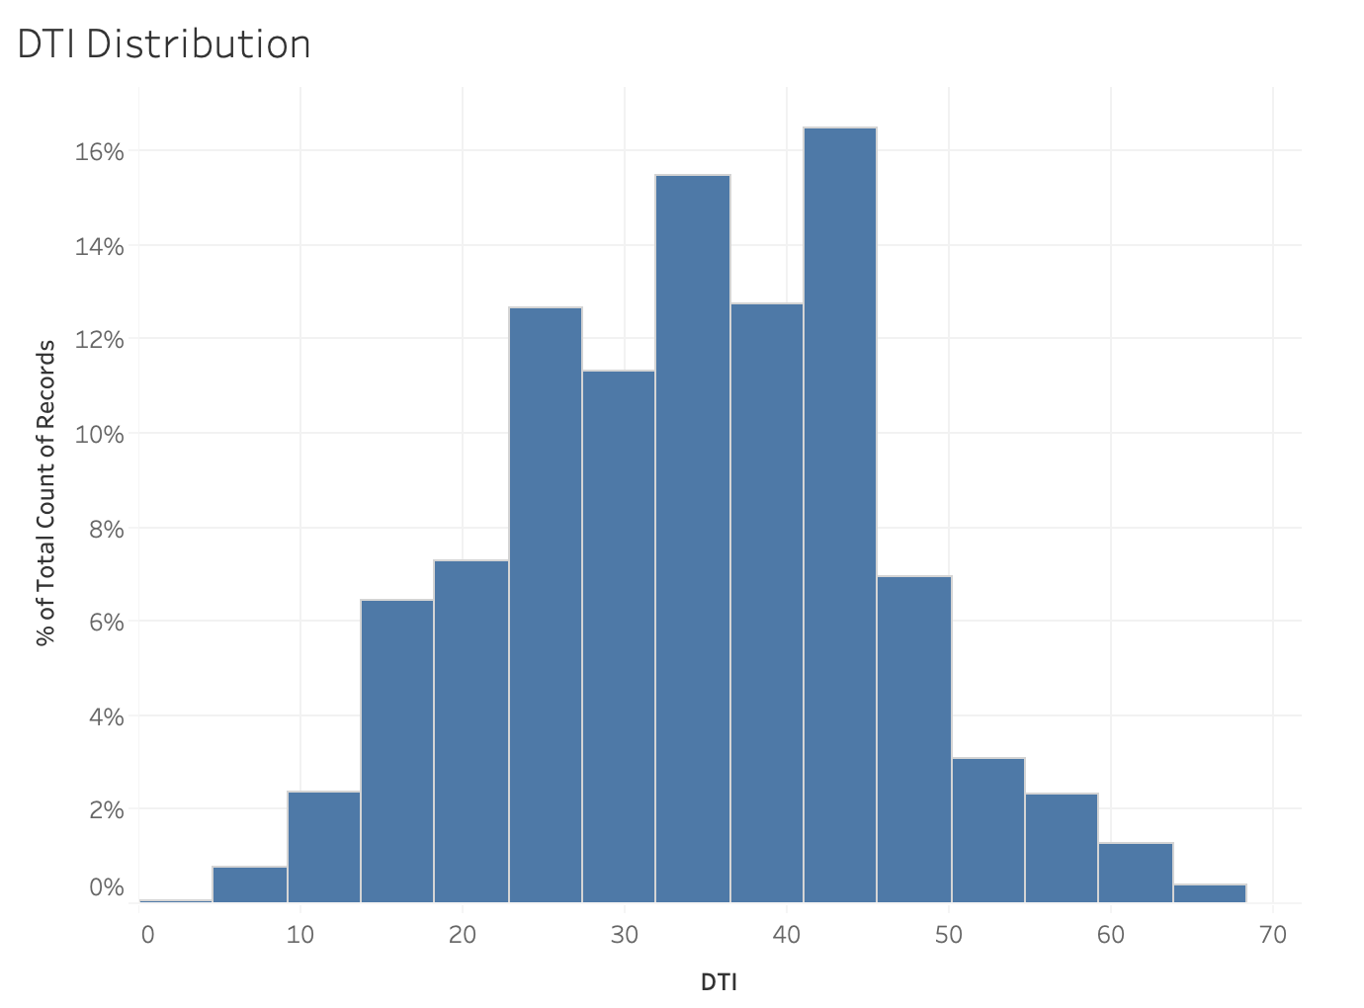
EDA——DTI Distribution
Median DTI is between 40% to 45%
Notes:
A ratio calculated at origination derived by dividing the borrower’s total monthly obligations (including housing expense) by his or her stable monthly income. This calculation is used to determine the mortgage amount for which a borrower qualifies.

Slide 8
Feature Engineering & Feature Selection
Subsample 10,000 rows from data
Delete unrelated variables
like "ZB_DTE", "Zero.Bal.Code", "DispYr", "MODIR_COST", "MODFB_COST", "MODTOT_COST"
Delete numeric variables with too many ‘0’
like “INT_COST", "total_expense", "total_proceeds", "NET_LOSS", "NET_SEV", "Total_Cost"
Delete categorical variables which are imblanced
like "Seller.Name", "Servicer.Name", "STATE", "MOD_FLAG", "Product.Type", "Delq.Status"
Features related with “Money”
Log transformation
Same distribution and keep one——“original amount”
Notes:
Save the computation and the time
Log transformation: to scale the data

Slide 9
Feature Engineering & Feature Selection
Deal with missing values
DTI: replace null values with 45%
Number of borrowers: replace null values with 1
Deal with date data
Feature generation
loan_month: maturity date - original date
first_month: first date - original date
Unify the unit; use “month”
Turn categorical variables into binary variables
"ORIG_CHN", "FTHB_FLG", "PURPOSE","PROP_TYP", "OCC_STAT"
Data standardization Finally get 31 variables!!!

Slide 10
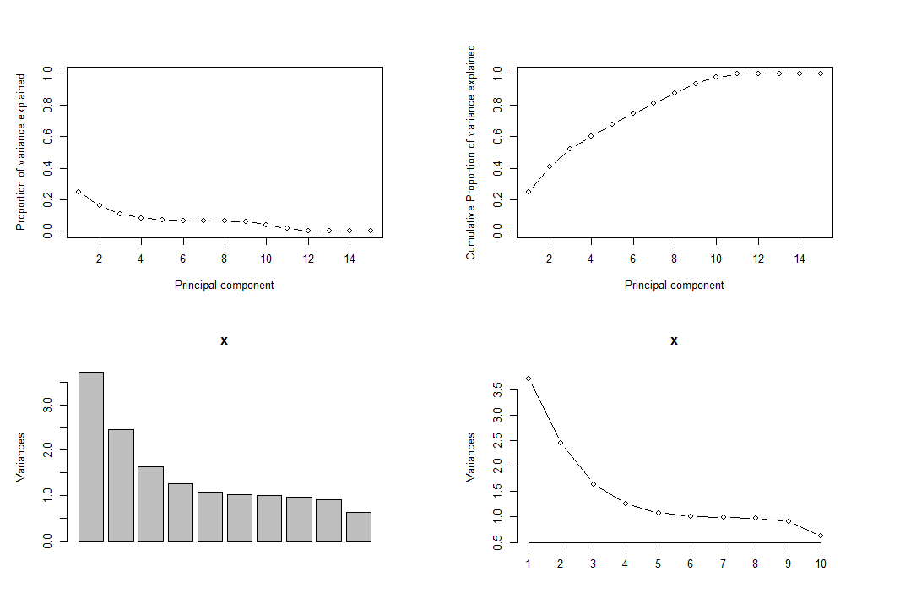
Demension Reduction
Method: PCA
Reduce 31 variables into 7 componets
Explain 81% of the data
Each component represents one feature
Notes:
Too many variables
We don’t know whether some of the data really represents one thing.
So we used PCA to reduce the dimension
We reduce the 31 dimensions to 7 dimensions and it can explain 81% of the data
And we will see each components represents one feature

Slide 11
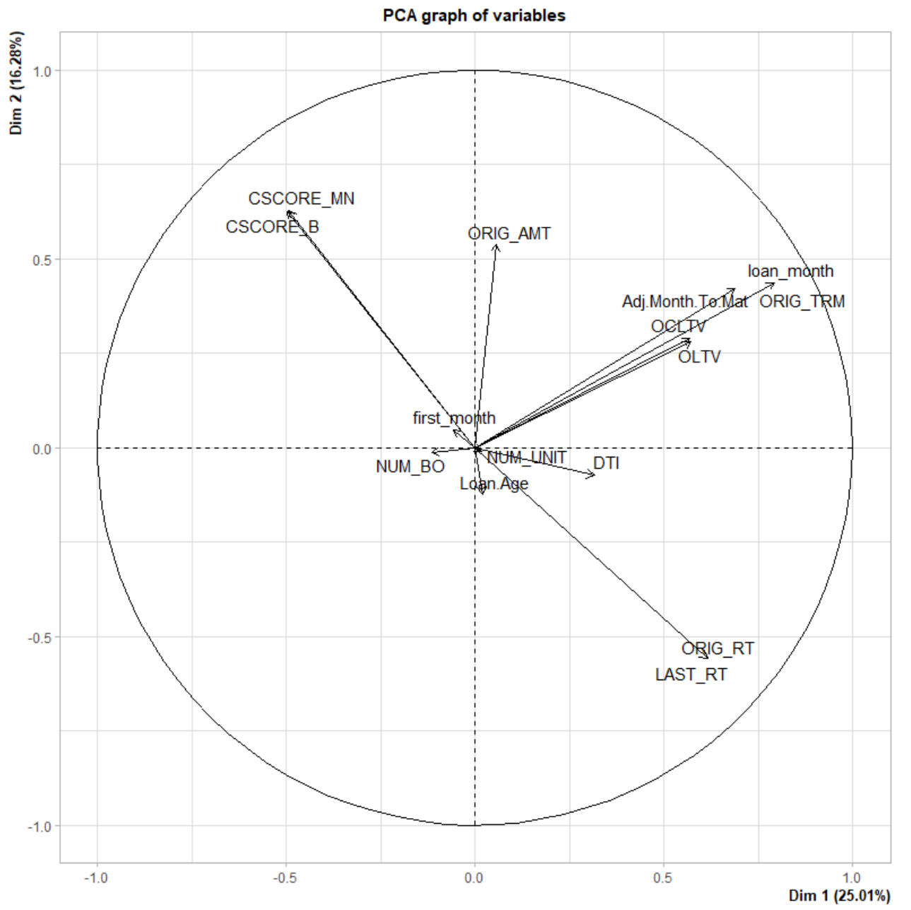
PCA Analysis
component1: Loan Term
component2: Loan Interest Rate
component3: OLTV
component4: Credit Score
component5: Number of Borrowers
component6: Number of Property Units
component7: First Payment Month
component8: Loan Age
component9: DTI (-)
component10: Original Loan Amount
Notes:
We can clearly see which features can be combined, I mean, they are in the same dimension
So finally wo get 7 components
ORIG_TRM: The number of months in which regularly scheduled borrower payments are due under the terms of the related mortgage documents (180 months and 360 months in this dataset).
ORIG_RT: the original interest rate of a loan
OLTV: Original loan to value, the ratio of a loan to the value of a property
CSCORE: the credit score of a borrower; higher credit score means better credit
NUM_BO: the number of borrowers
NUM_UIT: the number of property units
Months between loan date and the first payment date

Slide 12
Modeling Analysis Method
Step 1: use the PCA transformed data (10 components)
Step 2: build the models
K-Means, K-Medoids, DBSCAN, Mean-shift, GMM
Step 3: cluster visualization
Step 4: compare models
Step 5: cluster analysis (based on the best model)

Slide 13
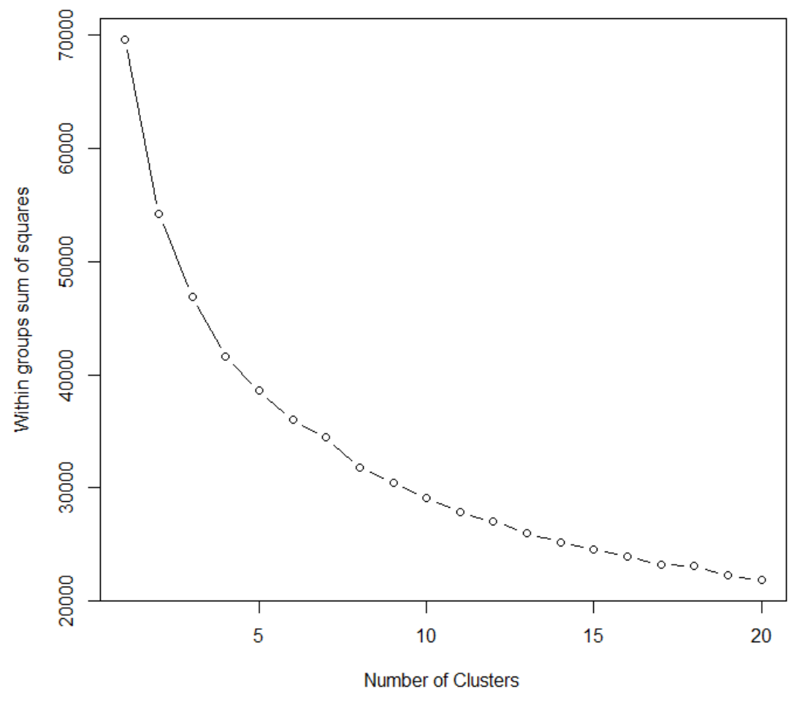
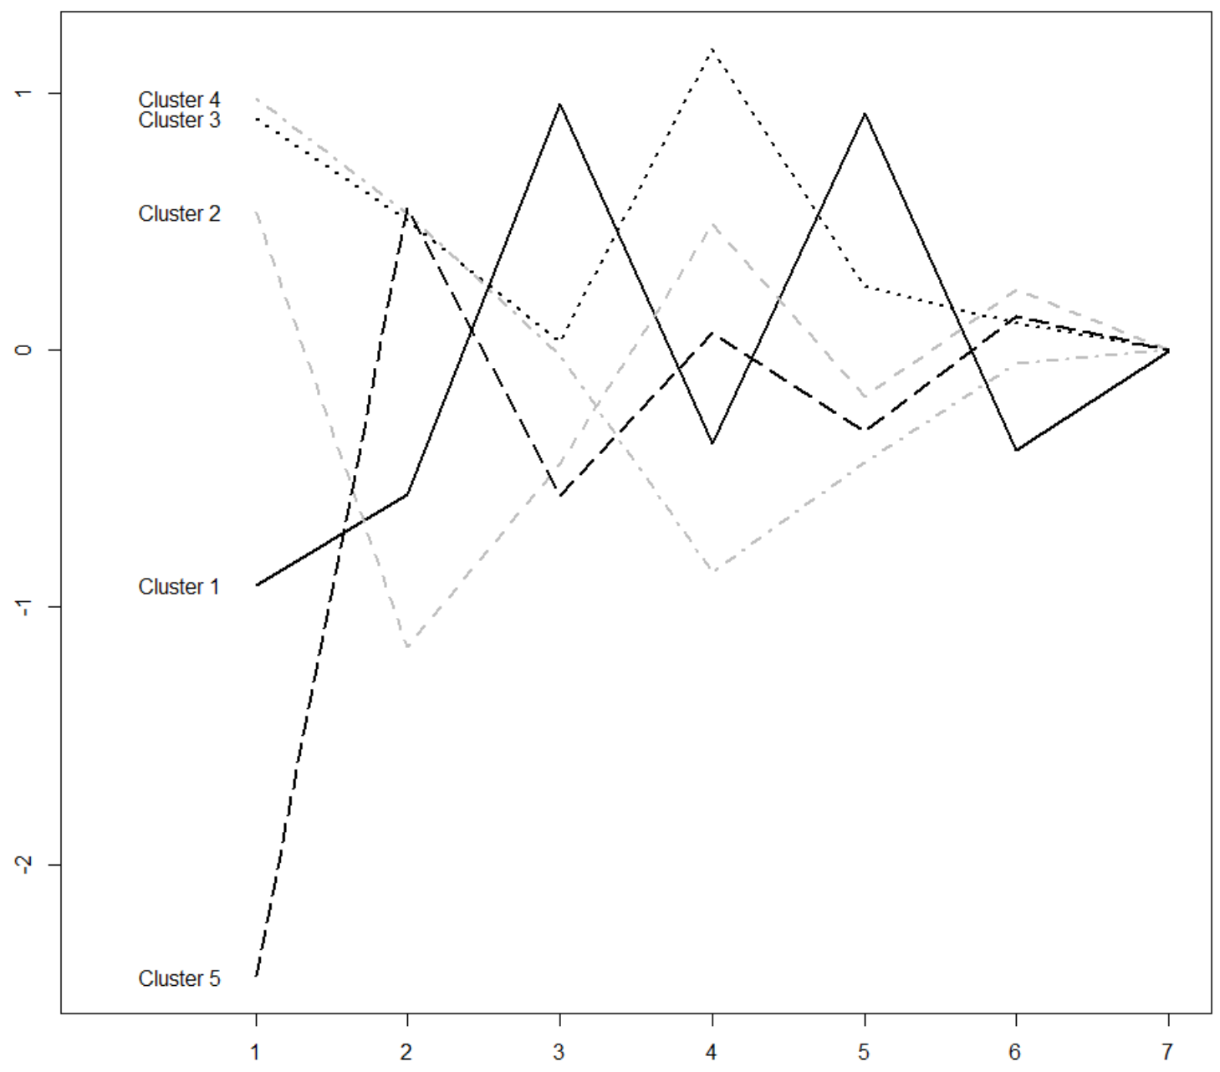
K-Means
Use distance-based measurements to determine the similarity between data points
Minimize the total squared error from a central position in each cluster
5 clusters
Standardize the data to have a mean of zero and a standard deviation
Notes:
one of the most popular clustering algorithms
use distance-based measurements to determine the similarity between data points

Slide 14
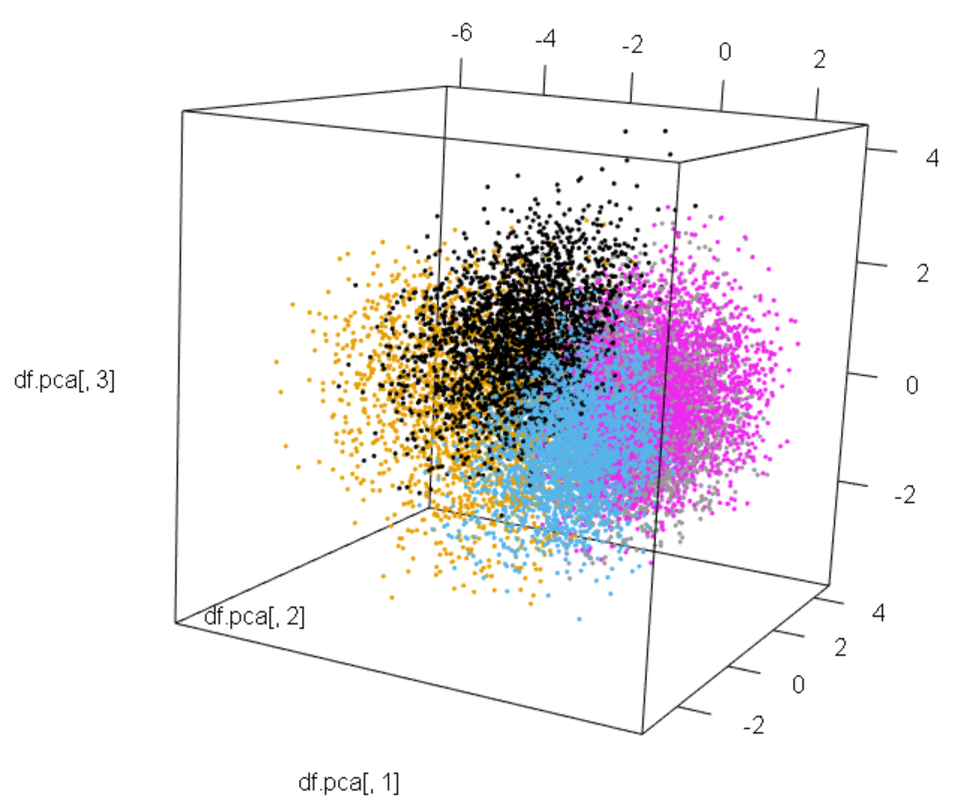
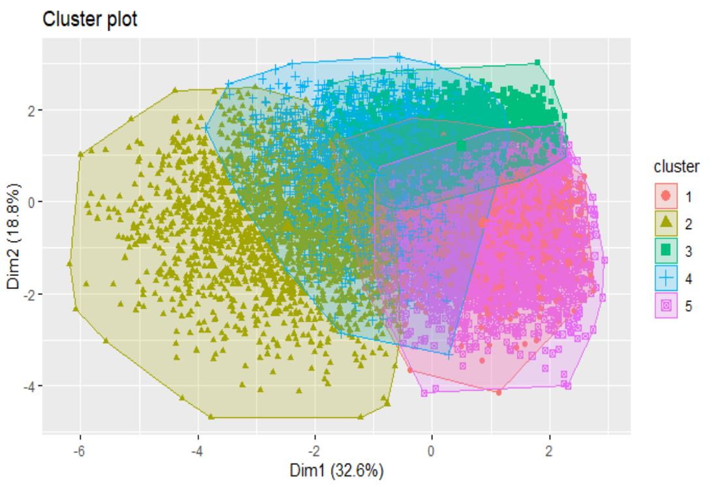
K-Means Visualization
K-Means 2D plot
K-Means 3D plot

Slide 15
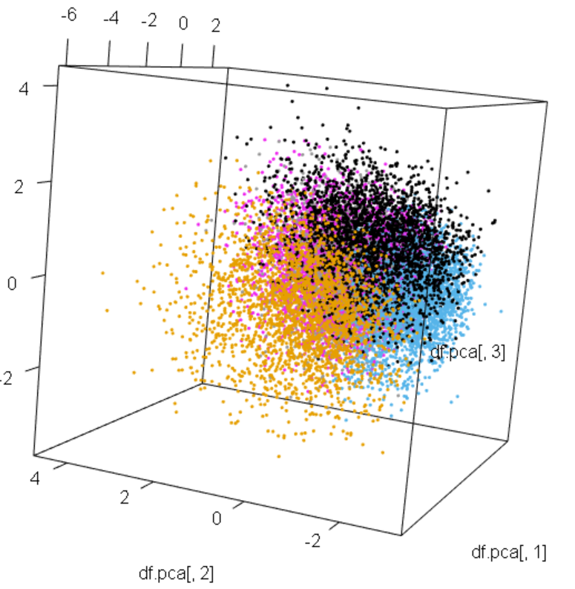
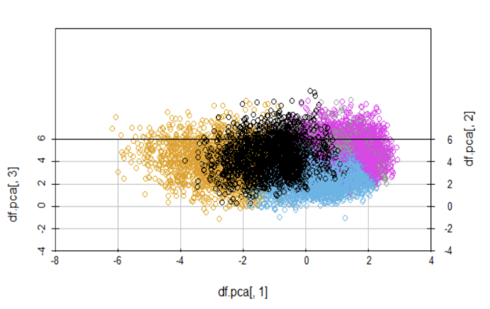
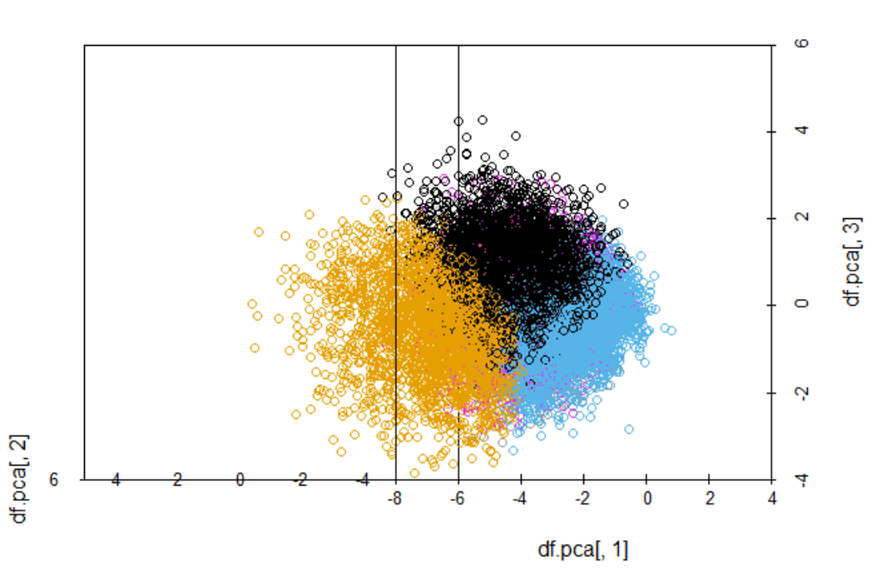
K-Means Visualization
angle = 90
angle = 180
K means 3D plot

Slide 16
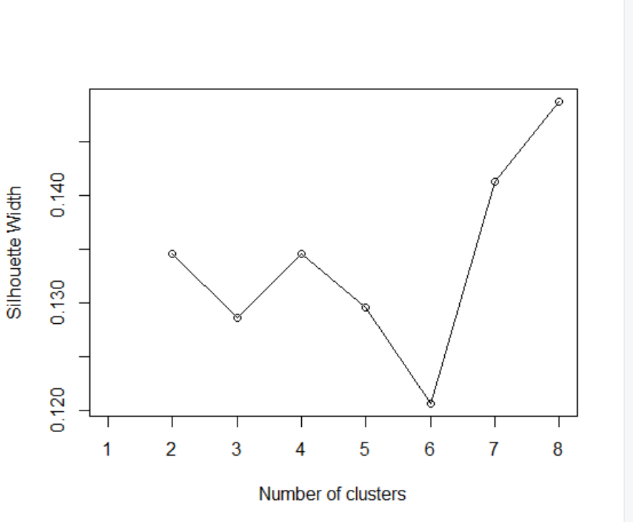
K-Medoids
Gower distance: a method to measure the distance of numeric and the similarity of categorical data
Use Silhouette Width to choose the best K
Robust to the outlier and correctly represents the cluster center

Slide 17
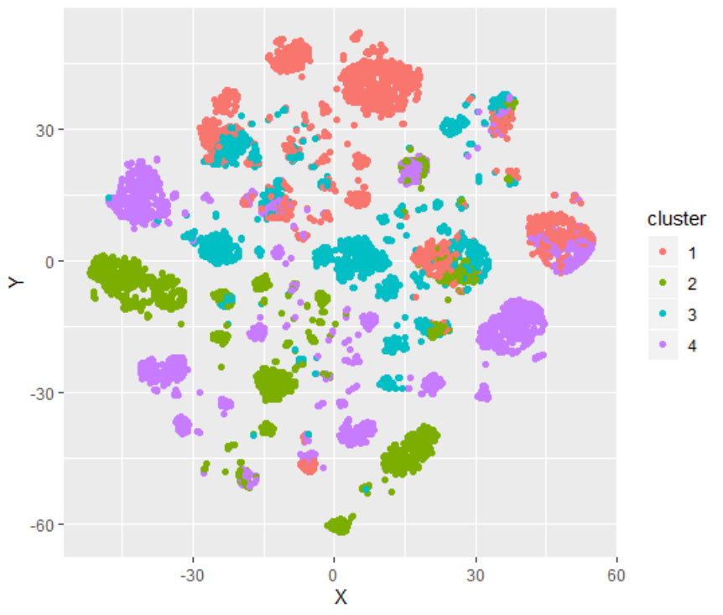
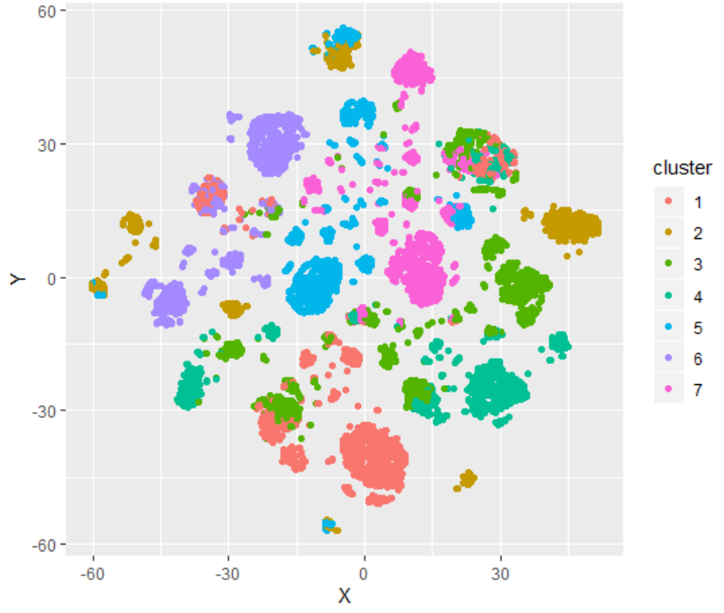
K-Medoids Visualization
K-Medoids 2D plot
Cluster = 4
K-Medoids 2D plot
Cluster = 7

Slide 18
Mean-Shift
Assign the data points to the clusters iteratively by shifting points towards the highest density of datapoints
Mean-shift does not require specifying the number of clusters in advance
Increase iteration and specified bandwidth (526 clusters -> 80)

Slide 19
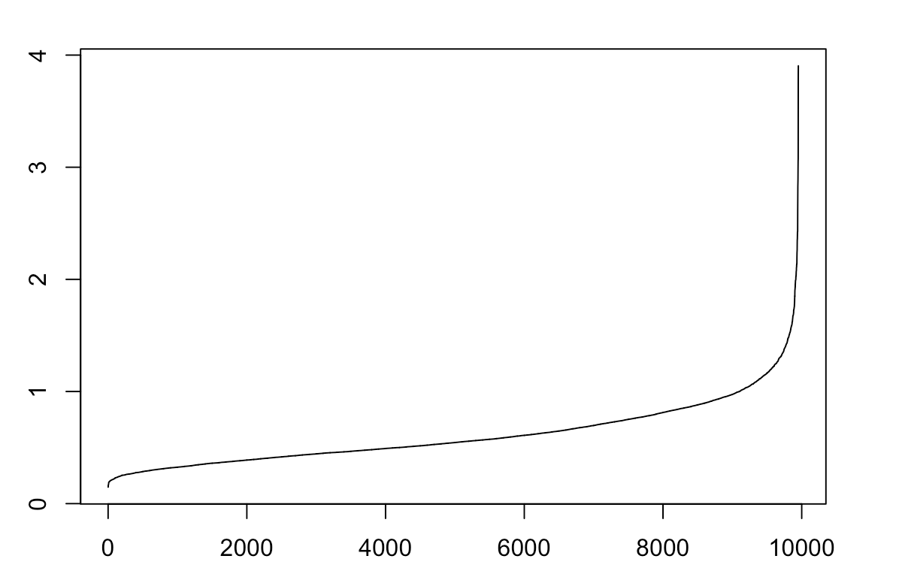
DBSCAN
Density-based spatial clustering of applications with noise
Determine the optimal eps value
DBSCAN is great at separating high density clusters from low density clusters
DBSCAN struggles with clusters of similar density
Points sorted by distance

Slide 20
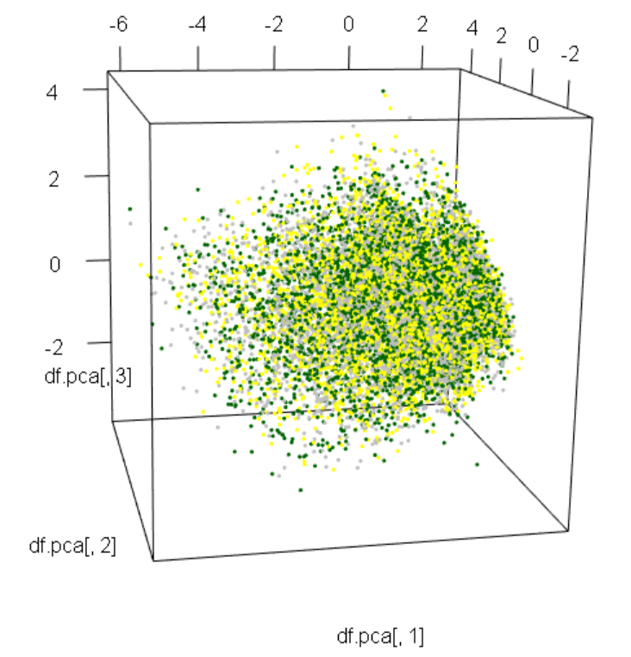
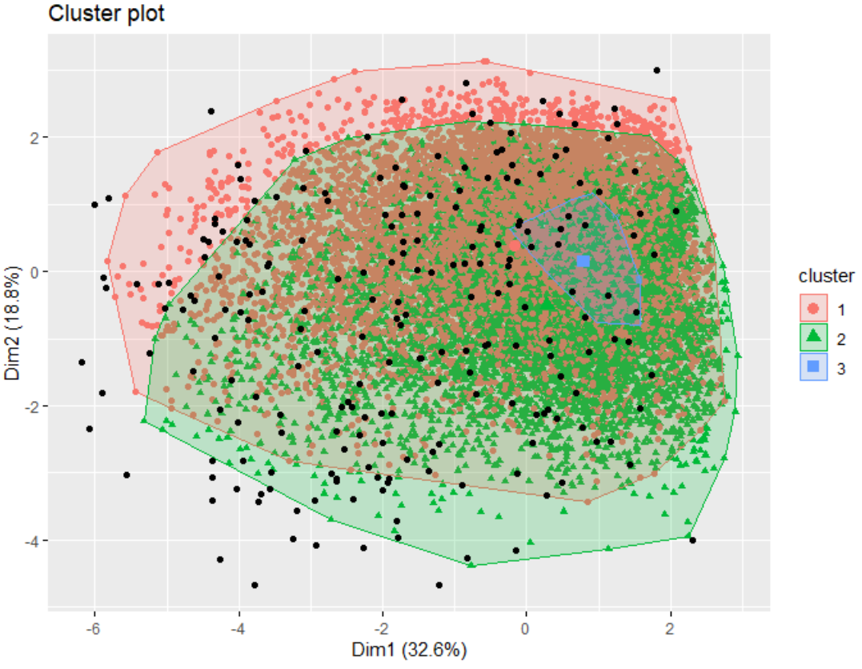
DBSCAN Visualization
DBSCAN 2D plot
DBSCAN 3D plot

Slide 21
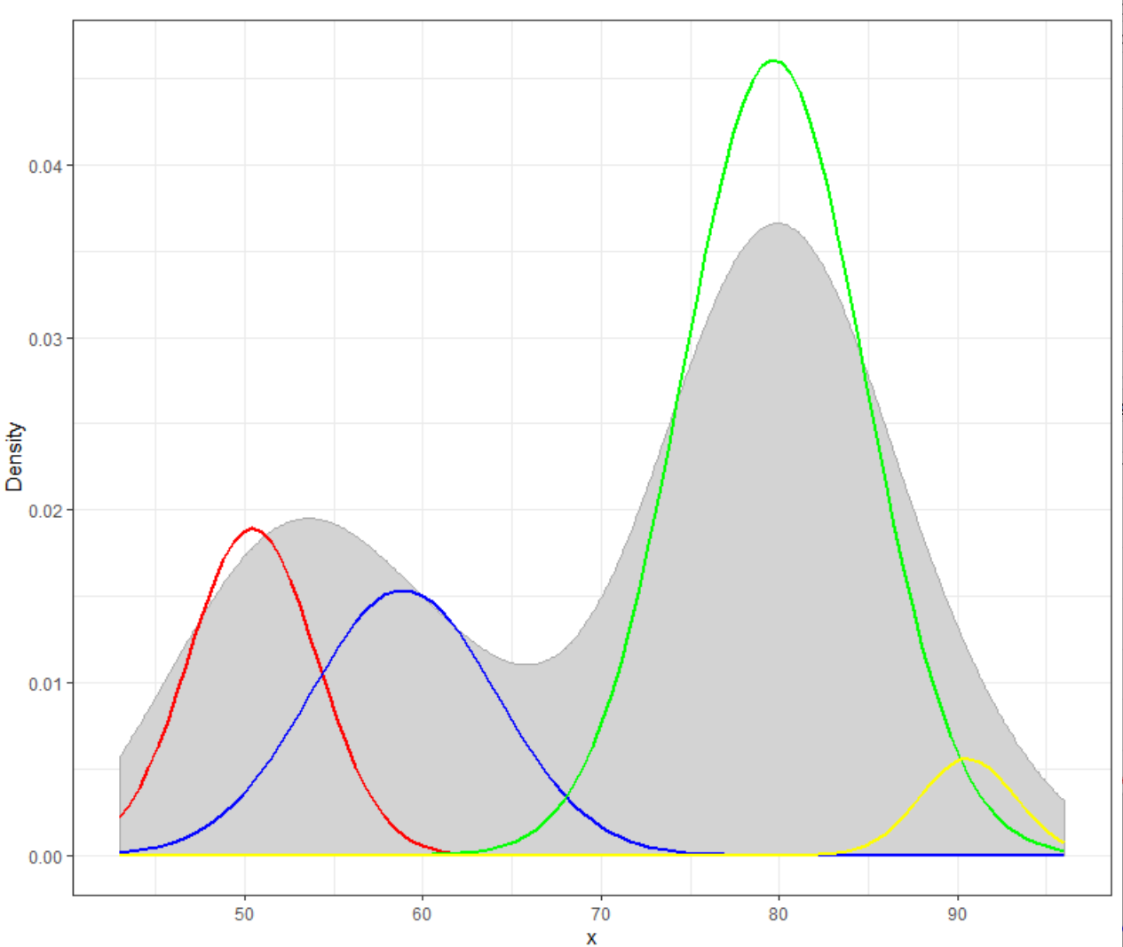
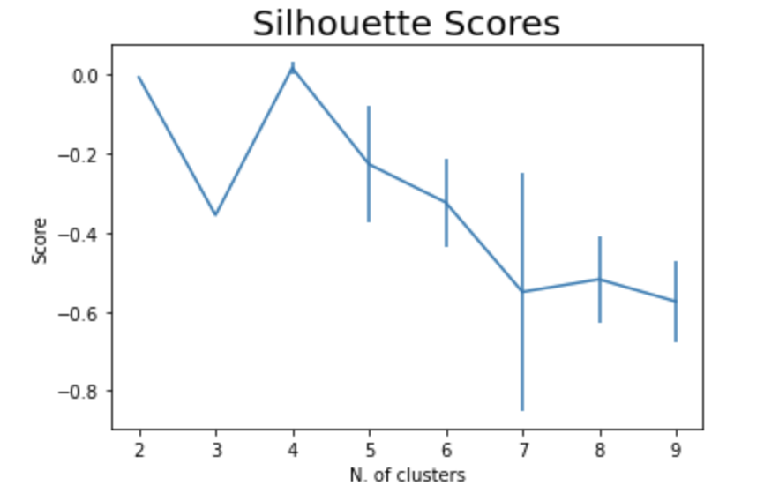
GMM
Gaussian Mixture: a function that is comprised of several Gaussians/normal distributions
Silhouette scores: determine the number of clusters
4 groups
Notes:
Gaussian Mixture: a function that is comprised of several Gaussians
The left graph shows the silhouette scores, which are used to determine the number of clusters needed to make GMM has the best performance
The right graph shows the normal distributions of the four clusters. We can see that there are overlaps of the red and the blue clusters. The yellow cluster has really small density and is mostly overlapped with the green cluster.

Slide 22
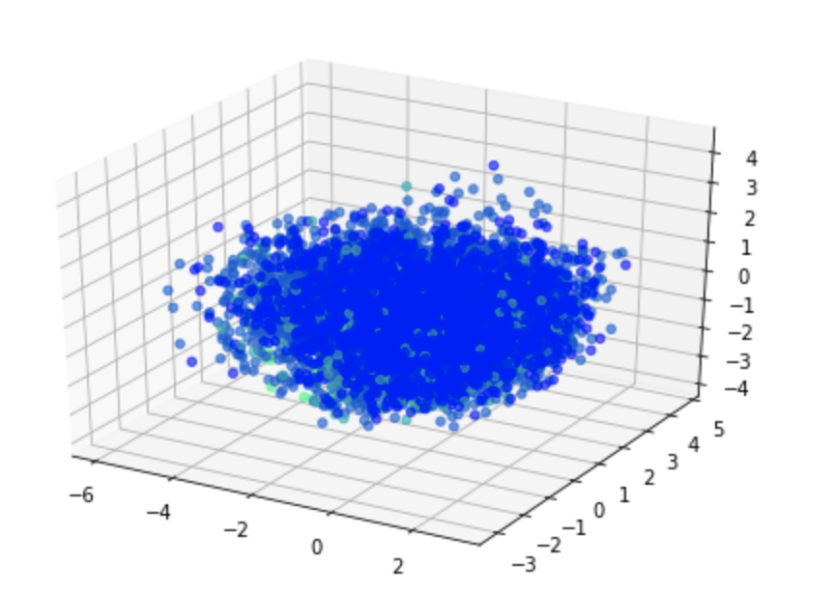
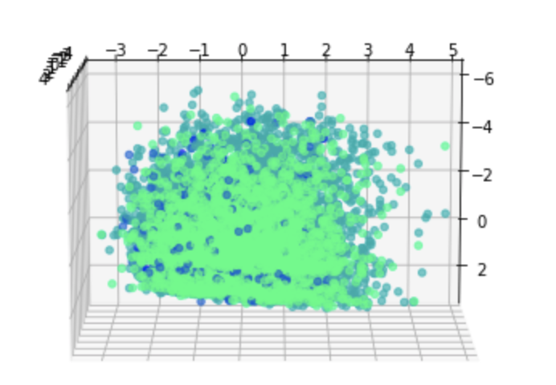
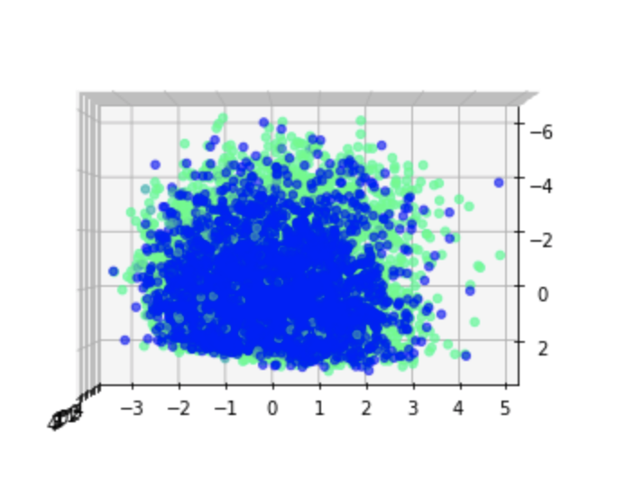
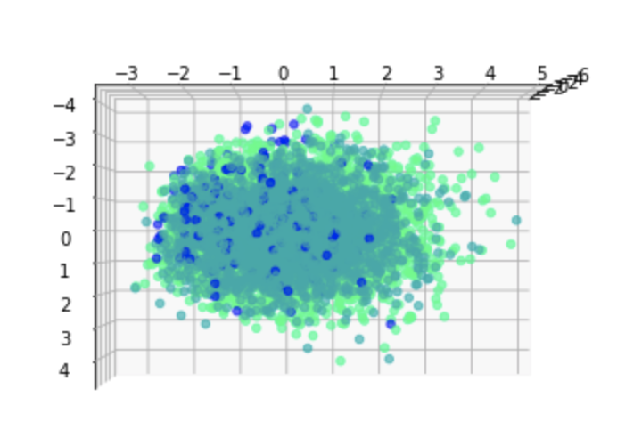
GMM Visualization
4 clusters in 3d plot
a lot of overlaps
very low silhouette scores
the clusters are not separated enough
GMM 3d plot
Notes:
These are the 3d plots of the GMM clusters in different angles. Even though we have 4 clusters, two of

Slide 23
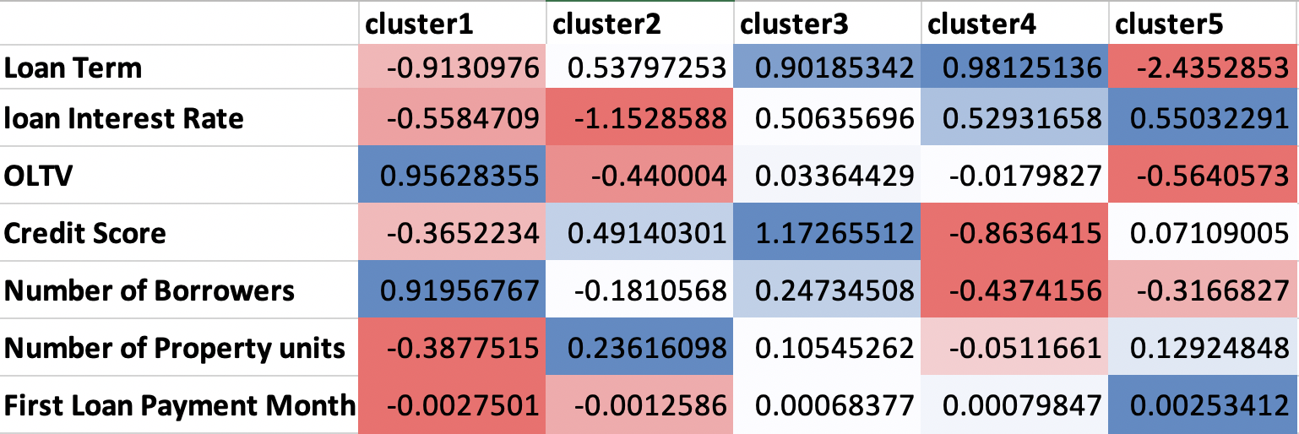
Cluster Analysis (Based on K-Means)
K-means has the best performance
Better and clearer clustering based on visualization
Fastest among all the other clusterding models
Easy to intercept and implement
Distance-based clustering: more suitable for our dataset

Slide 24
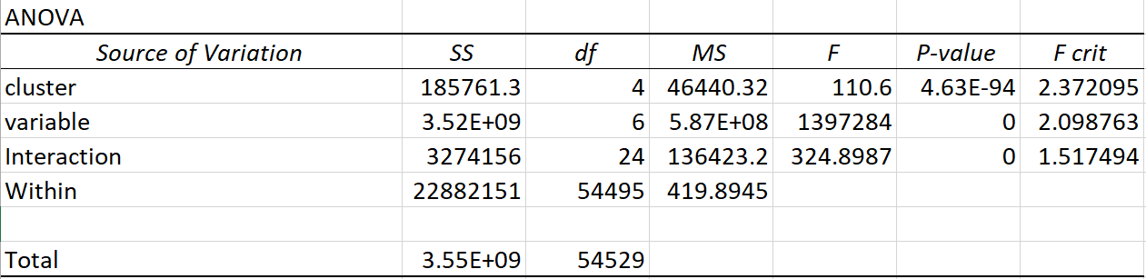
Two-way ANOVA Test
Results:
There exist significant difference between 5 clusters
There exist significant difference between variables
Clusters and variables are dependent with each other

Slide 25
Cluster 1
1,810 loans
Low original term (180 months/15 years, other clusters are 360 months/30 years)
Low original interest rate median: 4.38%
OLTV: 70%
Number of units and first months cannot differentiate the cluster
Borrowers have short-term mortgage loans with relatively low interest rates and smaller portions of the original values

Slide 26
Cluster 2
1,954 loans
Original term: 360 months
Credit score median: 760
Low original interest rate median: 4.5%
OLTV: 77%
Borrowers borrow larger portion of loans and need a longer time to make full loan payment

Slide 27
Cluster 3
1,759 loans
Credit score median: 714 (low)
OLTV: 80%
Original interest rate: 6.5% (highest among all the clusters)
Borrowers needed to pay higher interests because of their low credit score

Slide 28
Cluster 4
2,863 loans
Credit score median: ~740
Number of borrowers: 1 (all the other clusters are 2)
OLTV: 80%
Original term: 5.75 months
Borrowers have relatively lower credit scores, borrowed large portion of mortgage loan, and are responsible for the loans independently

Slide 29
Cluster 5
1,558 loans
Credit score median: 768 (highest)
OLTV: 42%
Original rate median: ~5.4%
Borrowers have good credits and borrowed the smallest portion of mortgage loans

Slide 30
Conclusion
Among all the clustering models, k-means clustering has the best performance
Cluster 1 borrowers: short-terms loans with low interest rate
Cluster 2 borrowers: long-term loans and good credit
Cluster 3 borrowers: bad credit and high-interest-rate loans
Cluster 4 borrowers: mediocre credit and independent
Cluster 5 borrowers: excellent credit with small amount of loans

Slide 31
Thank You!

Slide 32
Appendix: Feature Explanation
ORIG_TRM: The number of months in which regularly scheduled borrower payments are due under the terms of the related mortgage documents (180 months and 360 months in this dataset).
ORIG_RT: the original interest rate of a loan
OLTV: Original loan to value, the ratio of a loan to the value of a property
CSCORE: the credit score of a borrower; higher credit score means better credit
NUM_BO: the number of borrowers
NUM_UIT: the number of property units
First month: the difference of months between the original loan insurance date and the first payment date

